Slide 1

Differences between
Transformations and Actions

Slide 2
Spark Operations
Transformations
Transformations are lazy operations. Not completed when you write and execute the code.
Actions
An action is composed of one or more jobs, which consists of tasks that will be executed by the workers in parallel where possible.

Slide 3
Transformations
Transformations create new RDDs from existing RDDs in PySpark.
They are lazy, meaning they are not executed immediately.
Transformations are evaluated lazily when an action is called.

Slide 4
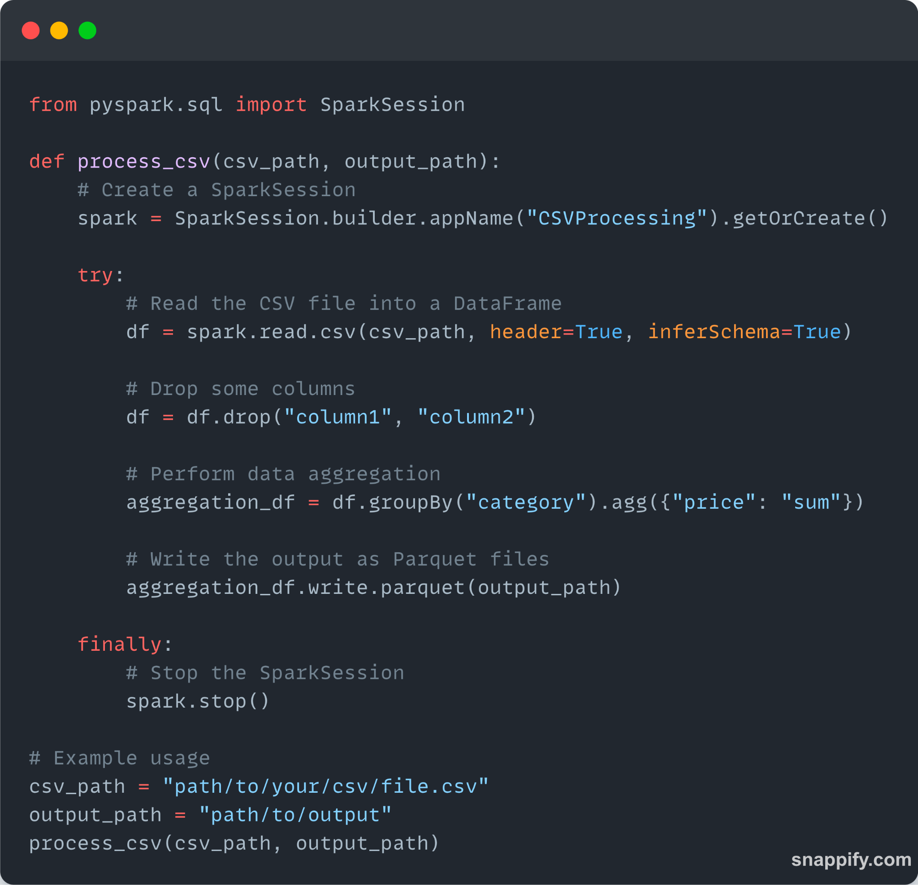
Transform: data generation and processing
select()
Selecting a column
read
Loading data
filter()
Data Filtering
groupBy()
Aggregation by group
sort()
Sorting data

Slide 5
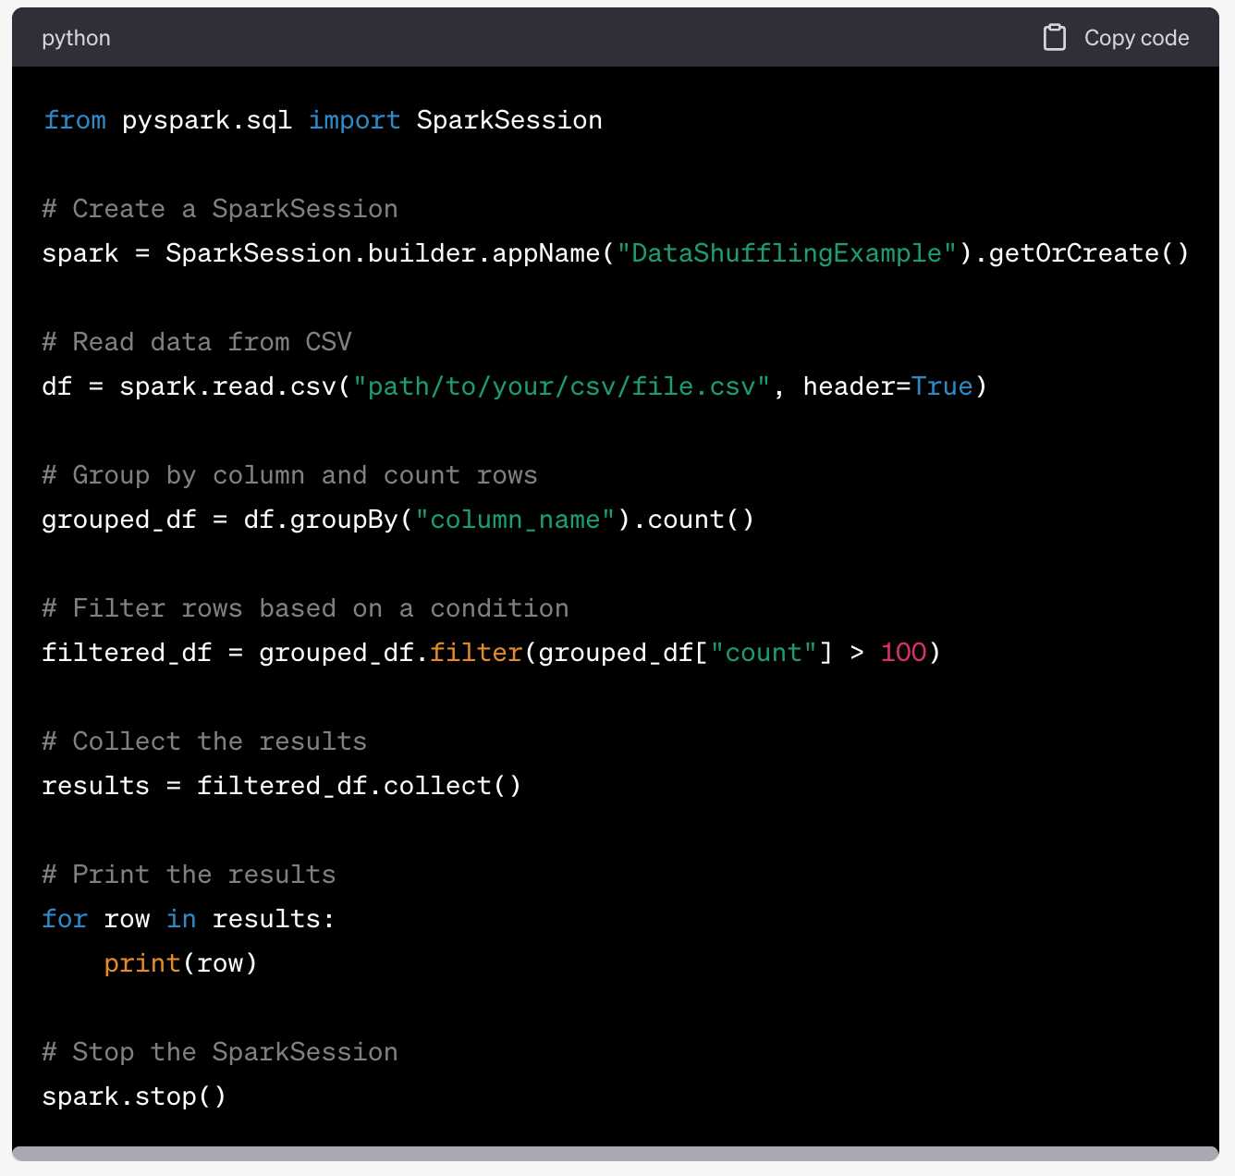
Transformations
Examples of transformations include group, map, filter, reduceByKey, join, etc.
They define the logical execution plan of the data processing.

Slide 6
Actions
count()
Counting the number of records
write
Exporting to the file system
collect()
Collect all data on Driver node
show()
View a sample of the data
describe()
View data statistics

Slide 7
Actions
Examples of actions include collect, count, reduce, save, foreach.
Actions materialize the data and terminate the execution flow.

Slide 8
Actions
Actions trigger the execution of transformations and produce results.
Actions initiate the computation in PySpark.
They return results or perform side effects on the data.

Slide 9
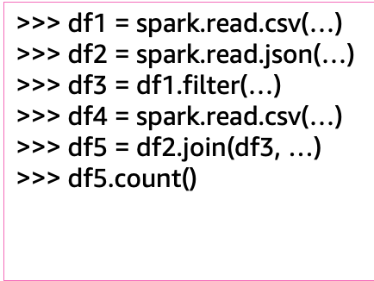
Lazy evaluation: Action vs transformation
Transformations: up to this point, no actual processing won’t be done.
Action! at this point, the previous process is executed for the first time.
The df4 process is not a dependency of df5.count(), so it will not be executed in this action.

Slide 10

Next…

